Slide 1
Midterm Project
Alejandro C Parra

Slide 2

Types of Models
Linear Regression
Multiple Linear Regression
Auto Regression (Using previous values as inputs)
Log transformation
Dummy or Intervention Variables

Slide 3

Models tested
TargetValue ~ Trend + season
TargetValue ~ Trend + season + Weight
TargetValue ~ lag(TargetValue)
TargetValue ~ Trend + lag(TargetValue)
TargetValue ~ Season + lag(TargetValue)
TargetValue ~ Trend + season + lag(TargetValue)
TargetValue ~ Trend + season + PandemicStart
TargetValue ~ Trend + season + PandemicStart + lag(TargetValue)
log(TargetValue) ~ Trend + season + lag(log(TargetValue))
log(TargetValue) ~ Trend + season + PandemicStart + lag(log(TargetValue))

Slide 4
Results

Slide 5
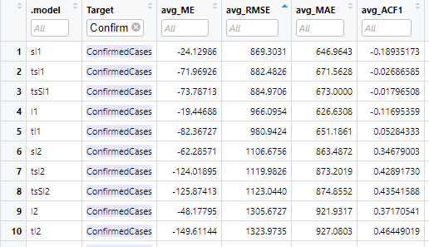
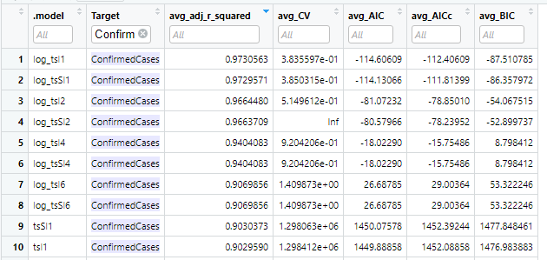
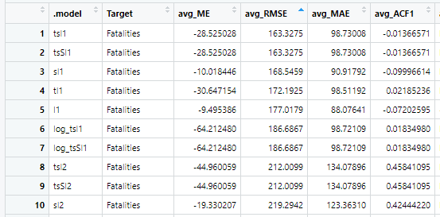
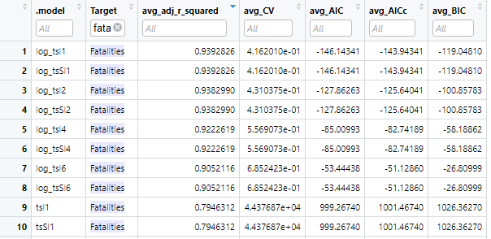
For Us, Canada, Italy and Germany

Slide 6
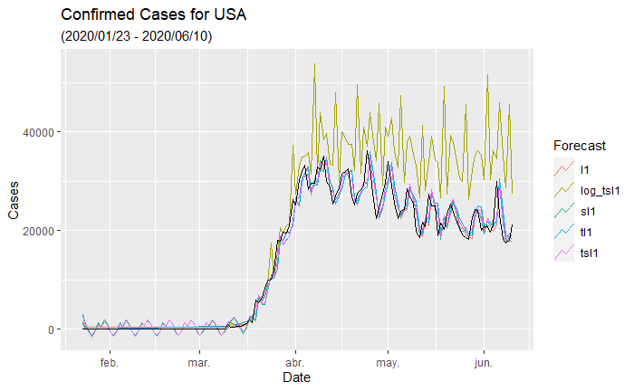
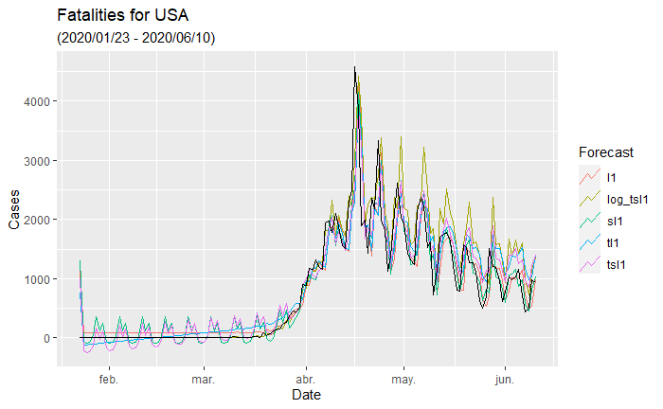
For USA

Slide 7

Conclusions
Weight variable: We can see that the models that used the variable weights as a predictor obtained the worst results, this is expected since this variable do not change in any scenario, and only changed between scenarios, thus resulting in not a good predictor.
PandemicStart variable: we can see that using or not using this variable in the models don’t really make a big difference in the results, but overall, we can see that the models that used this variable underperformed with respect to their counterparts.
Lag: We can see that using lag increase the performance of the model, we can see that all the models with l<number lag> outperform the models without it, this means that the current value depends on previous ones, we also see that a the lower the lag is the greater performance we get, meaning that a lag of 1 achieved the best results. We can see that the best models in each of the tables uses a lag of 1.
Log: We can see that the log models where able to outperform the rest of them if we rank them using the adj. R², achieving values of over 0.9. But if we look at the ranking using the RMSE, we can see that the log models no longer top the ranking.

